Slide 1
KNU & Polije Project
Development of Household
mobile platform
Team 3 : 9220

Slide 2
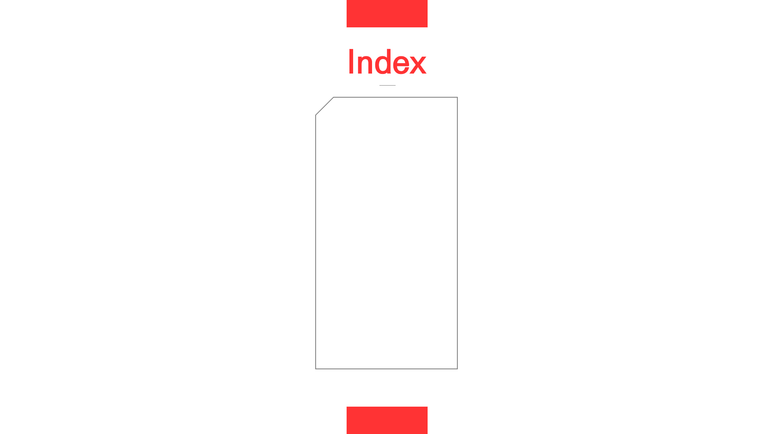
CONTENTS
Introduction
Background
App Design
Implementation
Expecting Effect

Slide 3
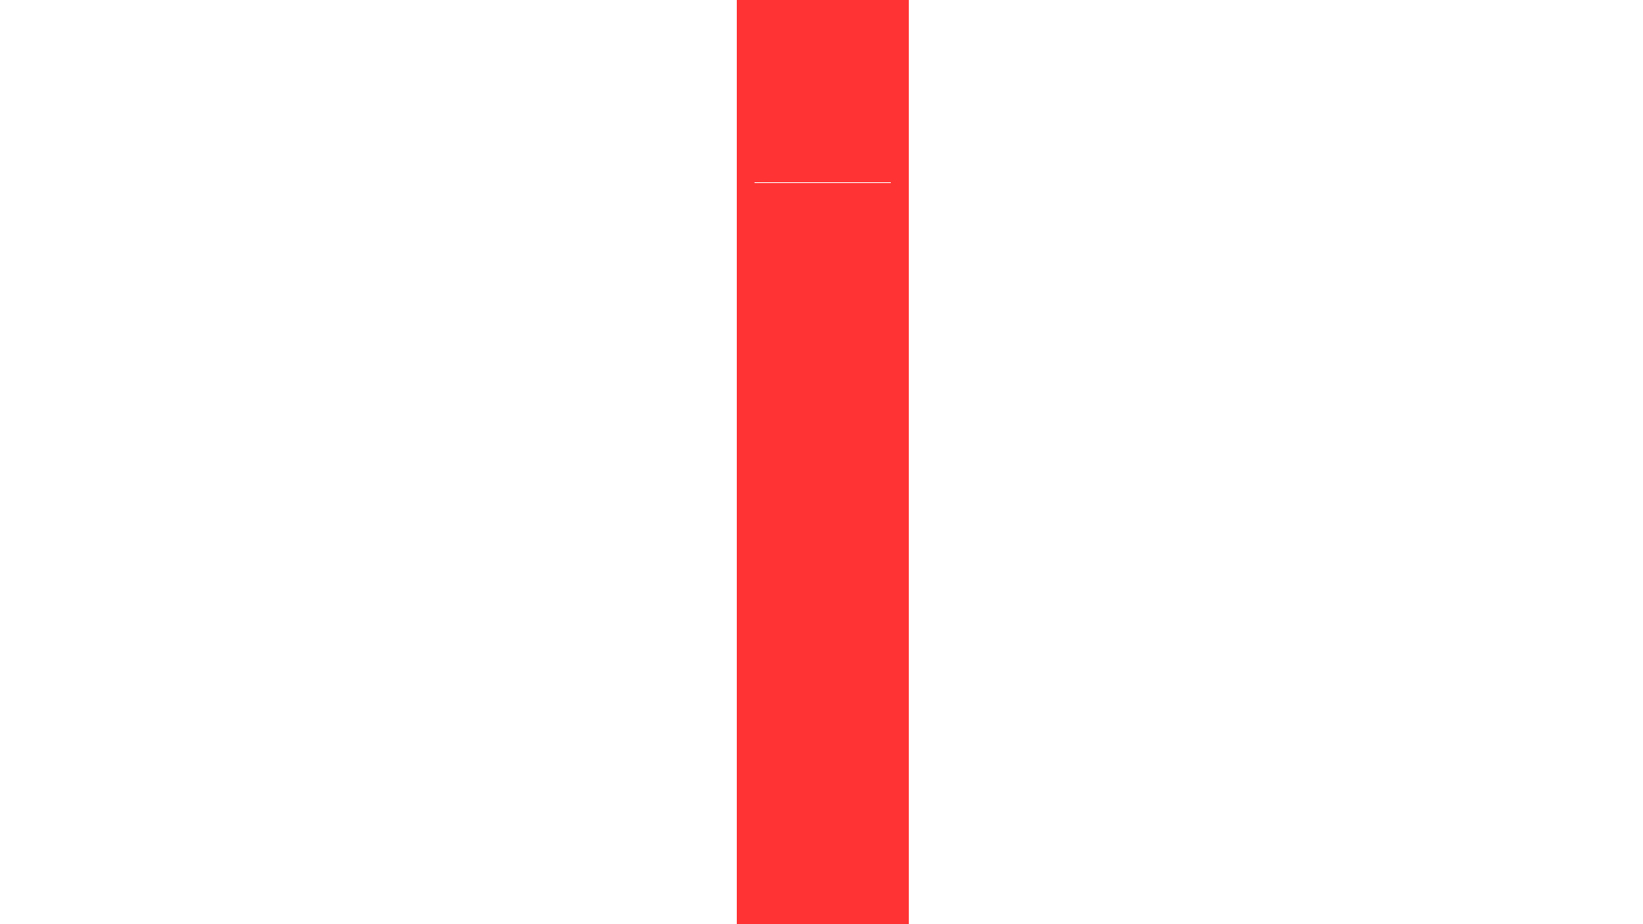

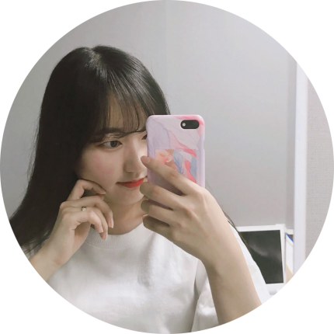



01
Introduction
Koo Minjeong PL
Computer Sience Engineering
Backend
Lee Yongmin TL
Computer Sience Engineering
Backend
Choi ahyoung CL
Lee Seun ML
Electronic Sience
Engineering
frontend
Computer Sience Engineering
UI Design, Document

Slide 4





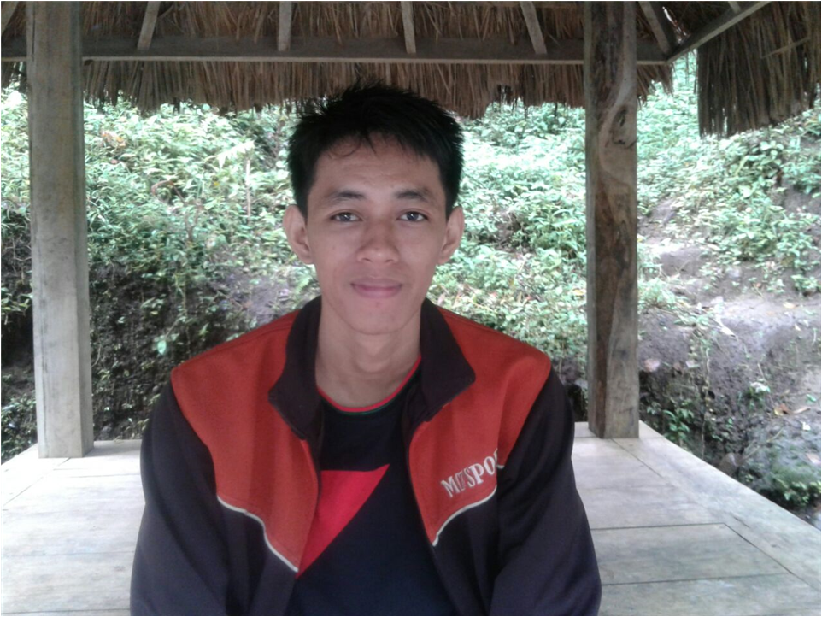
01
Introduction
Nanang Budi Utomo
Computer
Engineering
frontend
Husnul Hotimah
Computer Engineering
Backend
Dedy Bramayadi
Informatics
Management
UI Design
Dhany Rivaldi
Informatics
Management
UI Design
Vyan Ary Pratama
Computer
Engineering
Backend

Slide 5

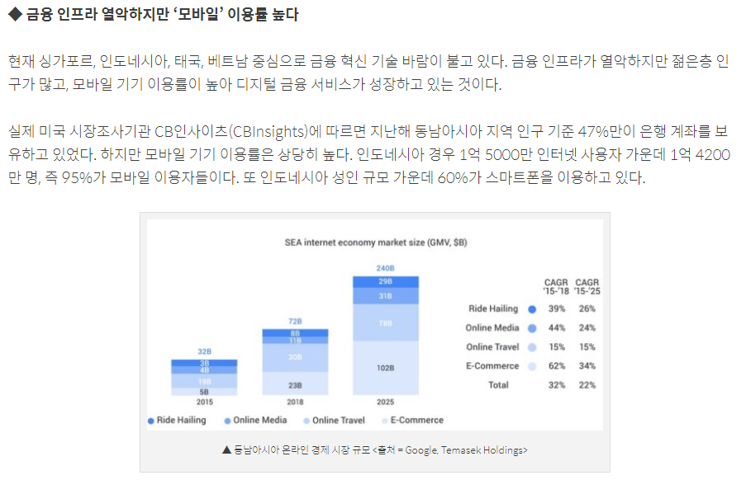
02
Background
* source : https://www.blockmedia.co.kr/archives/94155
Notes:
2019년 6월 13일 자료

Slide 6
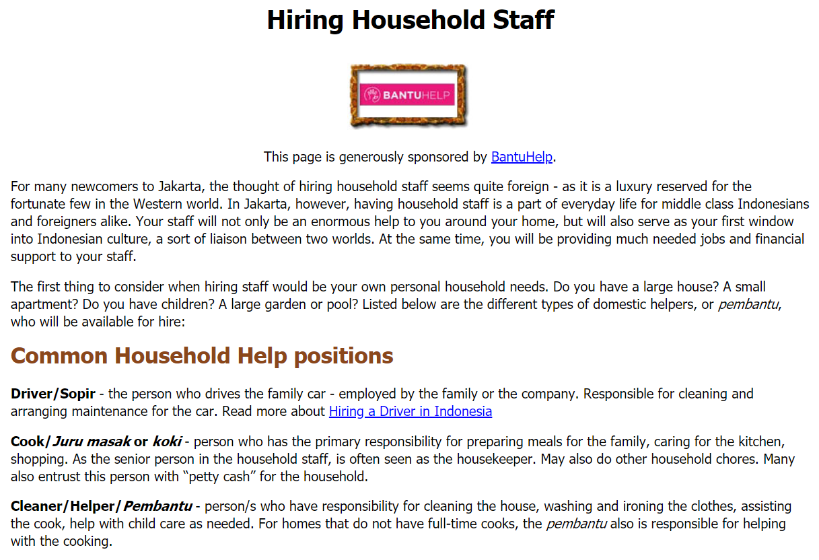
02
Background
* source : https://www.expat.or.id/info/hiringhouseholdstaff.html
Notes:
2019년 6월 13일 자료

Slide 7

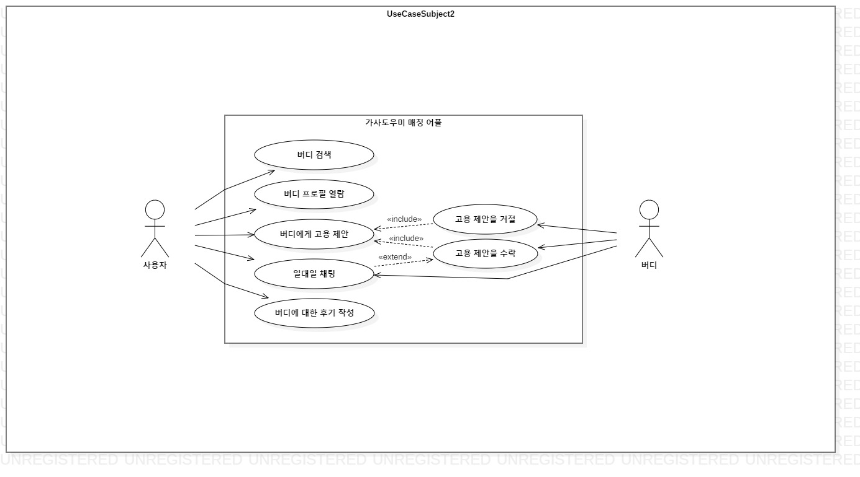
03
App Design - Use Case Diagram
matching household application
search buddy
read profile
proposal refusal
job proposal
proposal accept
Costomer
1 : 1 contact
Buddy
write a review

Slide 8
03
App Design - System Architecture
Android Studio
Node.js
MongoDB
Map
API
CLIENT
(Android app)
SERVER
DATABASE
request
MAIN
Location
Based
Service
response
Location
Based
Data
APP
routing
save/road data
request
response
Data
Processing
Service
User
Data
Transport Module
routing
save/road data
request
response

Slide 9
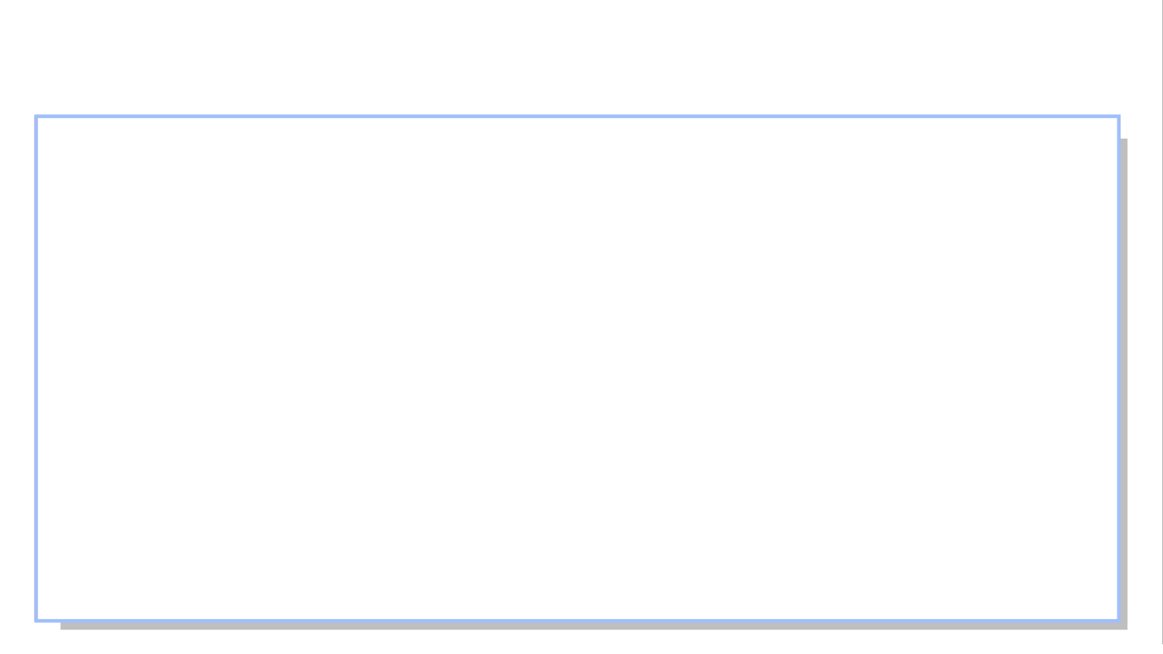
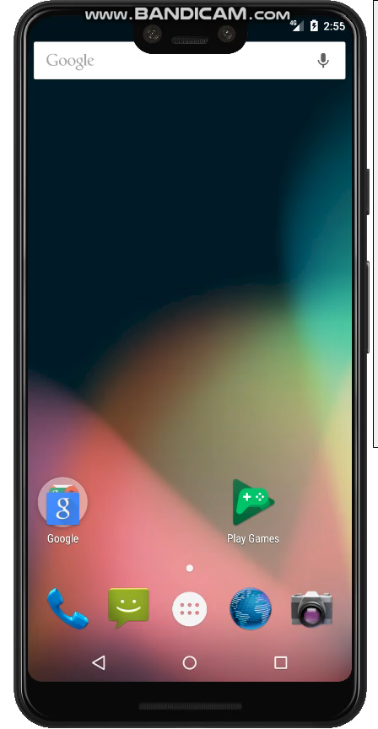
04
Implementation - join membership

Slide 10
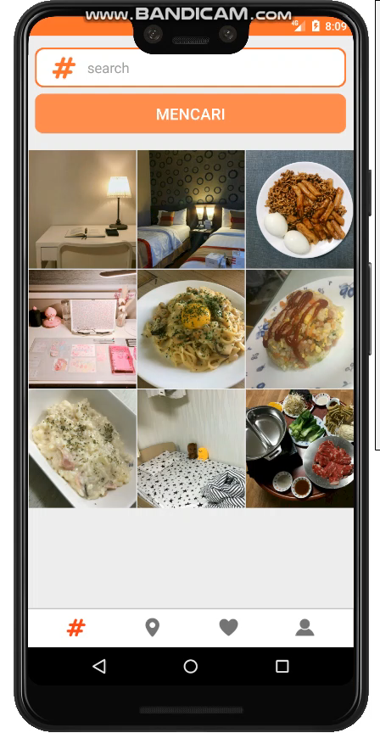
04
Implementation - hashtag search

Slide 11
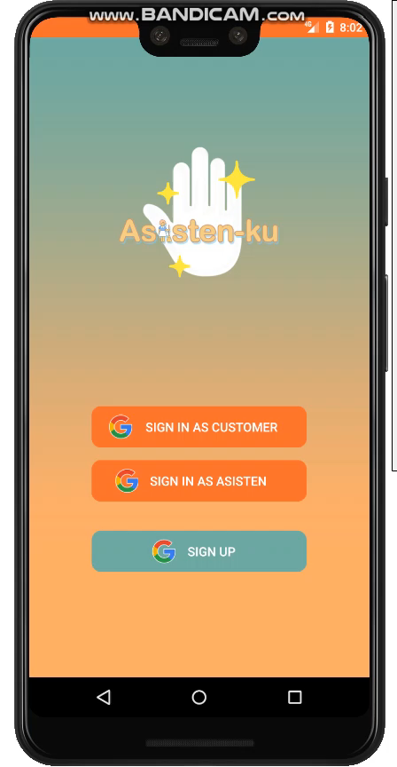
04
Implementation - Location based search

Slide 12
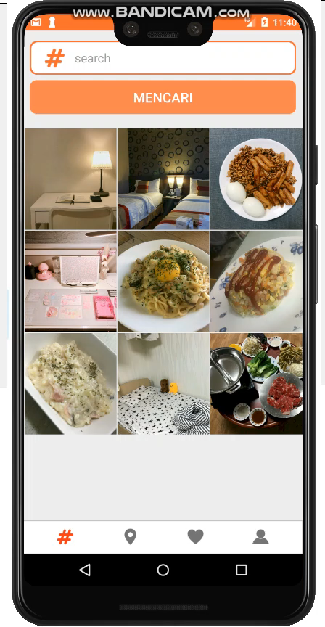
04
Implementation - Preferred Assistant and Photo

Slide 13
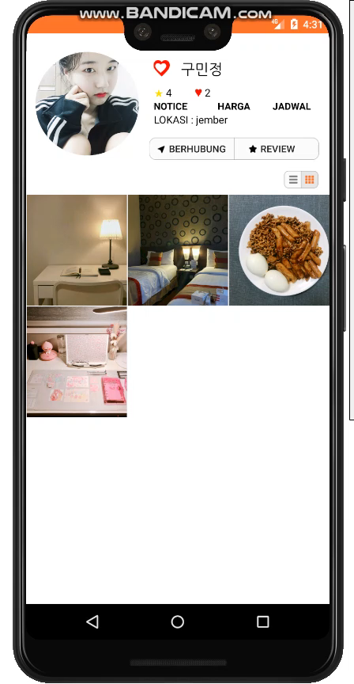
04
Implementation - send job suggestion

Slide 14
04
Implementation - proposal permission and contact

Slide 15

04
Implementation - write review

Slide 16



04
Exffecting effect
Save time and money because you can find jobs and hire without intermediaries
Users can easily access the service they want, such as reading the information of the household helper, chatting on a 1:1 real-time basis, and writing reviews.

Slide 17

THANK YOU
Notes:
지금까지 발표를 들어주셔서 감사합니다. 질문 있습니까/

